Slide 1
Parking Detection
Joshua Jardenil, Andrew Bell, Alan Ortega, Seamus Kennedy

Slide 2
Problem: Parking
Notes:
Main issue arises from parking, especially at Fresno State
Hard finding parking spots
Zigzag stuff

Slide 3
Solution:
Develop a program using hardware and software to detect parking spots and send it to a website

Slide 4
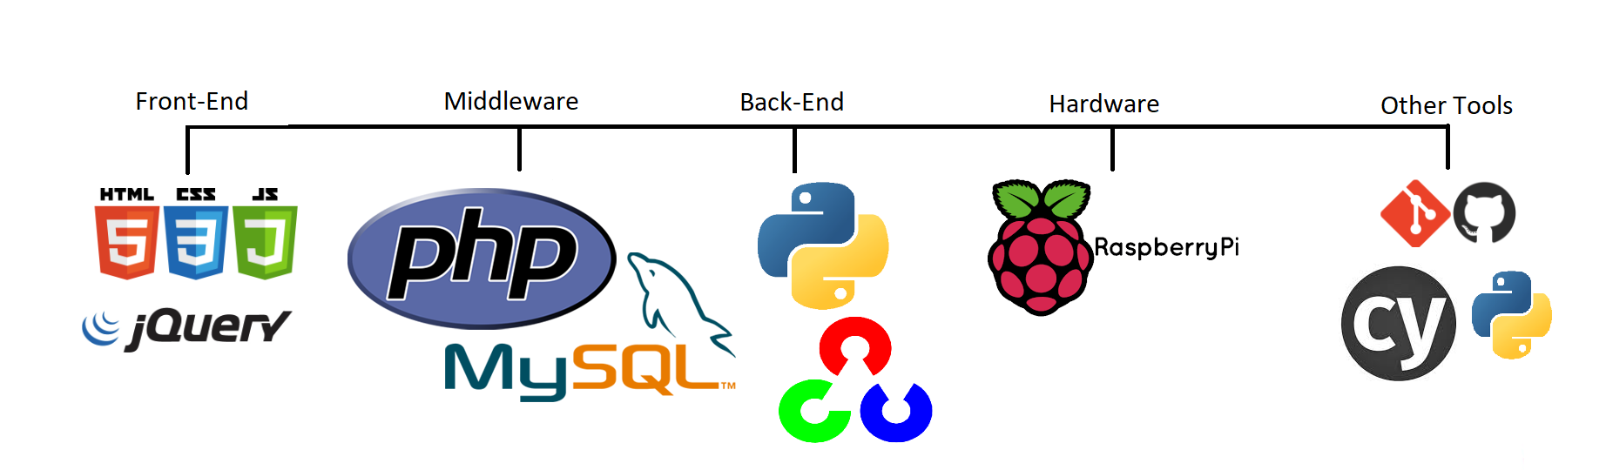
Tools
Notes:
Seamus starts here

Slide 5
Requirements
Original Requirements:
Backend code, designed for use of ultrasonic sensors.
Use image subtraction to average pixels values at a certain spot.
Current Requirements:
https://github.com/Alipongoy/CSCI152Pi/wiki/Documentation#requirements

Slide 6
Design
Two main classes
Abstractions for parking lot and parking spaces
Architecture
Followed a pipe and filter approach
Break dictionary up
Start with stream of data and filter it down
Coupling when passing whole objects

Slide 7
Backend Implementation

Slide 8
Backend Implementation Iterations
Using ultrasonic sensors and LED sensors
Using camera sensor
Notes:
Went through many iterations

Slide 9
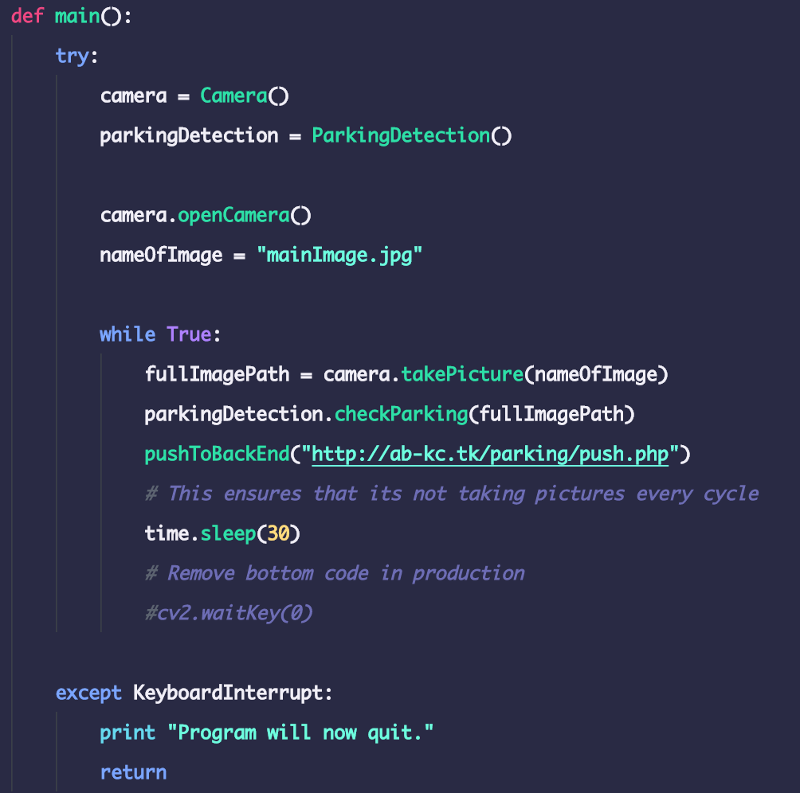
Classes in main.py
Camera Class
ParkingDetection Class
ParkingSpace Class

Slide 10
How It Works
Camera takes a picture
Picture goes through image recognition
JSON data containing available and unavailable parking spots are sent to Front End
Sleep for 30 seconds
Rinse and repeat

Slide 11
ParkingDetection class

Slide 12
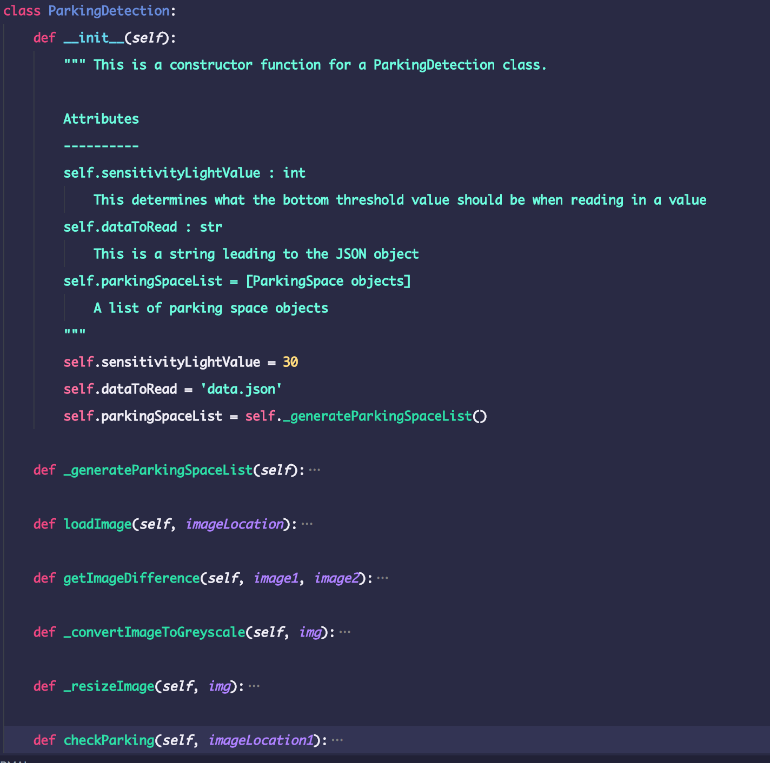
ParkingDetection Implementation
Contains a list (or array) of ParkingSpace objects
ParkingSpace objects are made from self._generateParkingSpaceList()
checkParking() uses image recognition to check parking on list of ParkingSpace objects

Slide 13
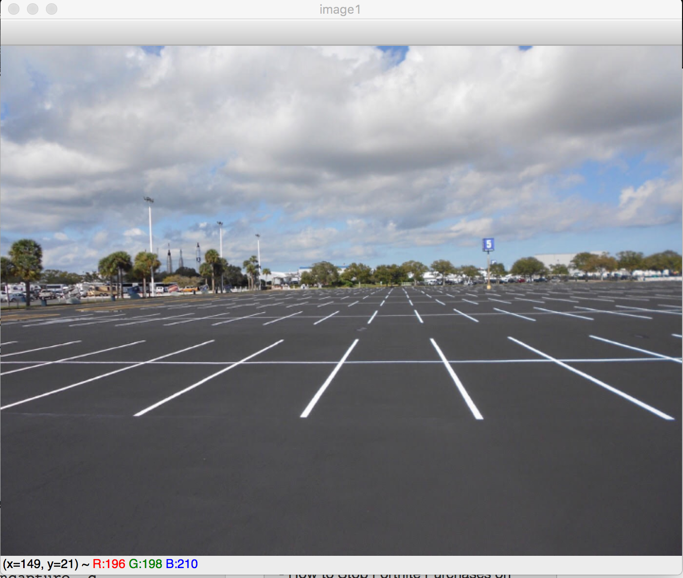
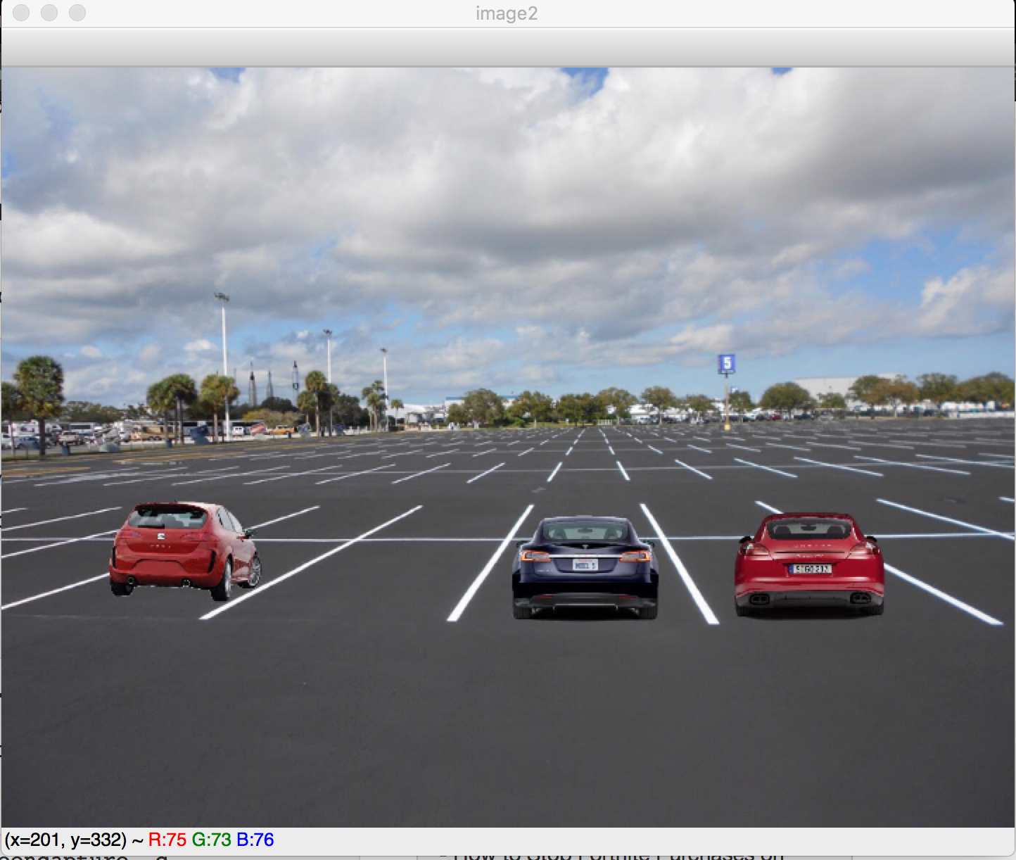
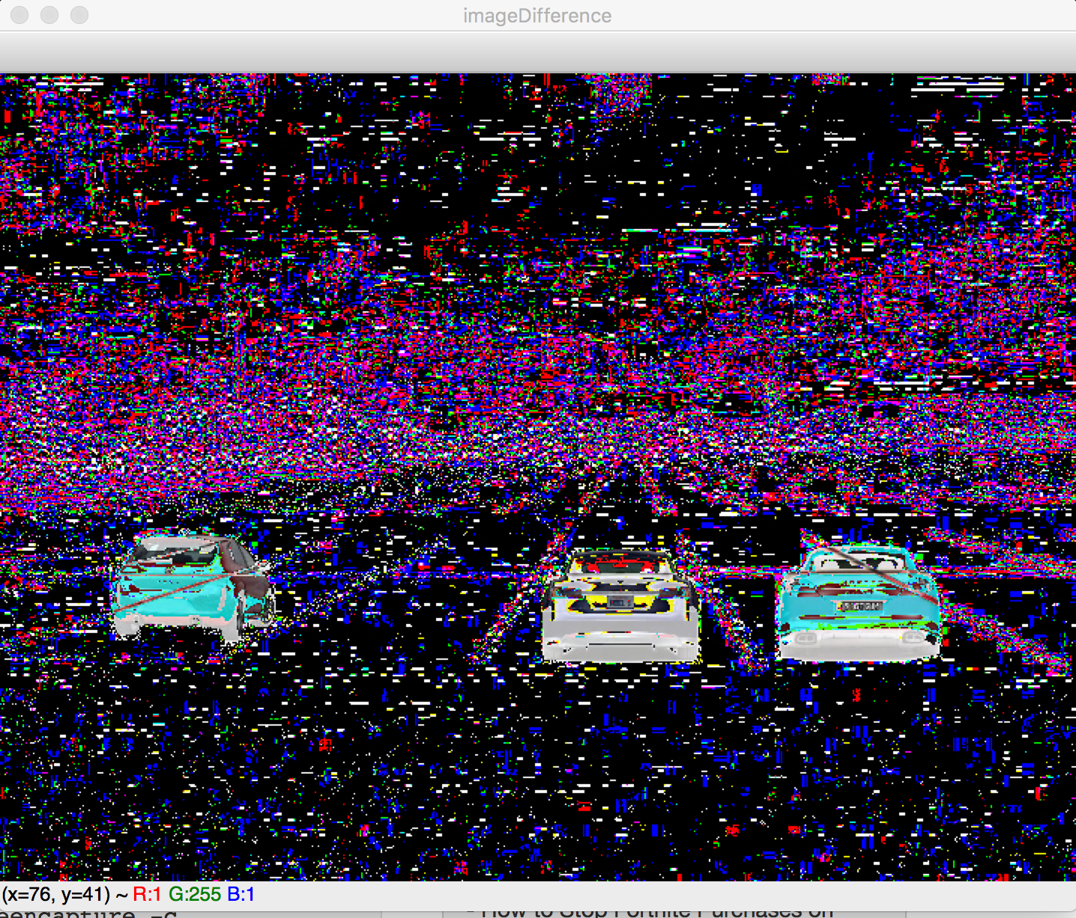
Original Image Recognition Method
Image with empty parking lot is stored
Camera takes picture of parking lot
Empty parking lot image is subtracted with the parking lot image and converted to greyscale
Average light densities of certain areas are found
If the average is higher than the threshold value, the spot has changed. Else, hasn’t changed

Slide 14
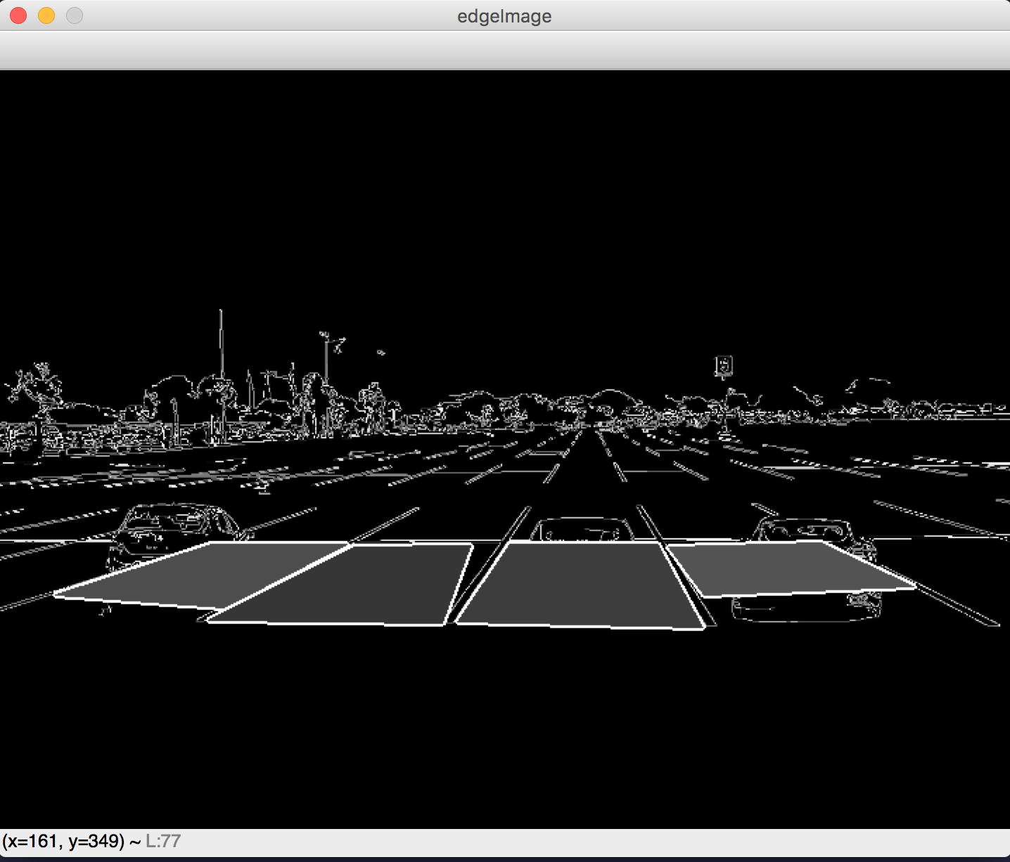

Slide 15
Problems with Original Recognition Method
If the camera moves while the second image is being taken, the image will be too bright
Average light densities will be too high
Difference in time of day will also increase the light density
Too complex to deal with
Notes:
Problems arise from using two images to subtract each other

Slide 16
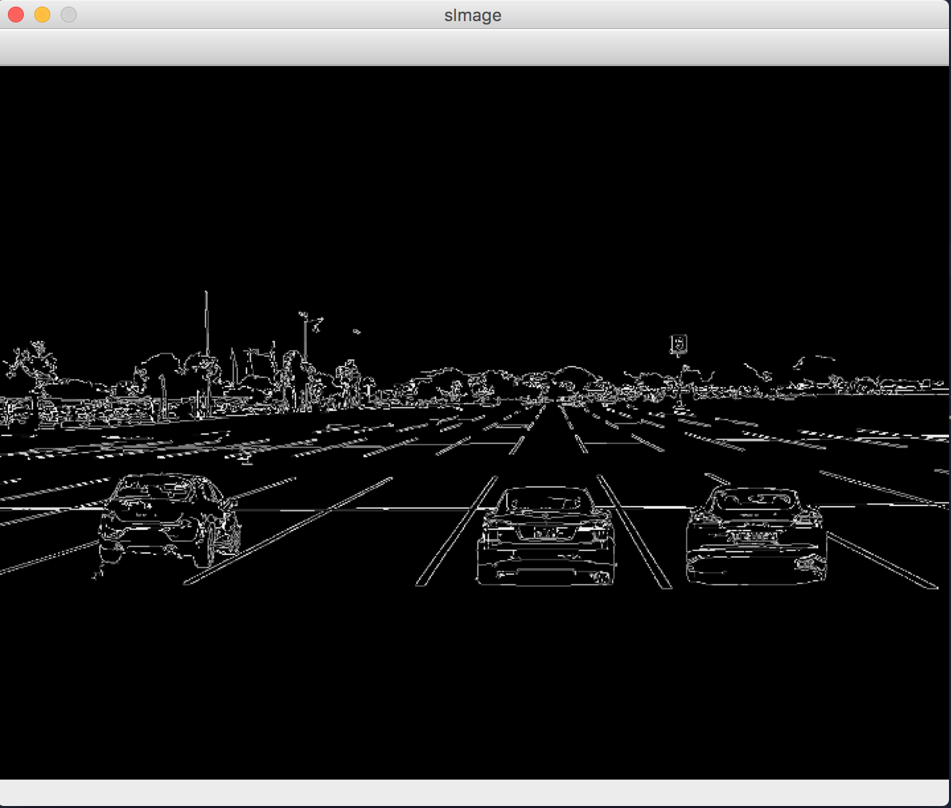
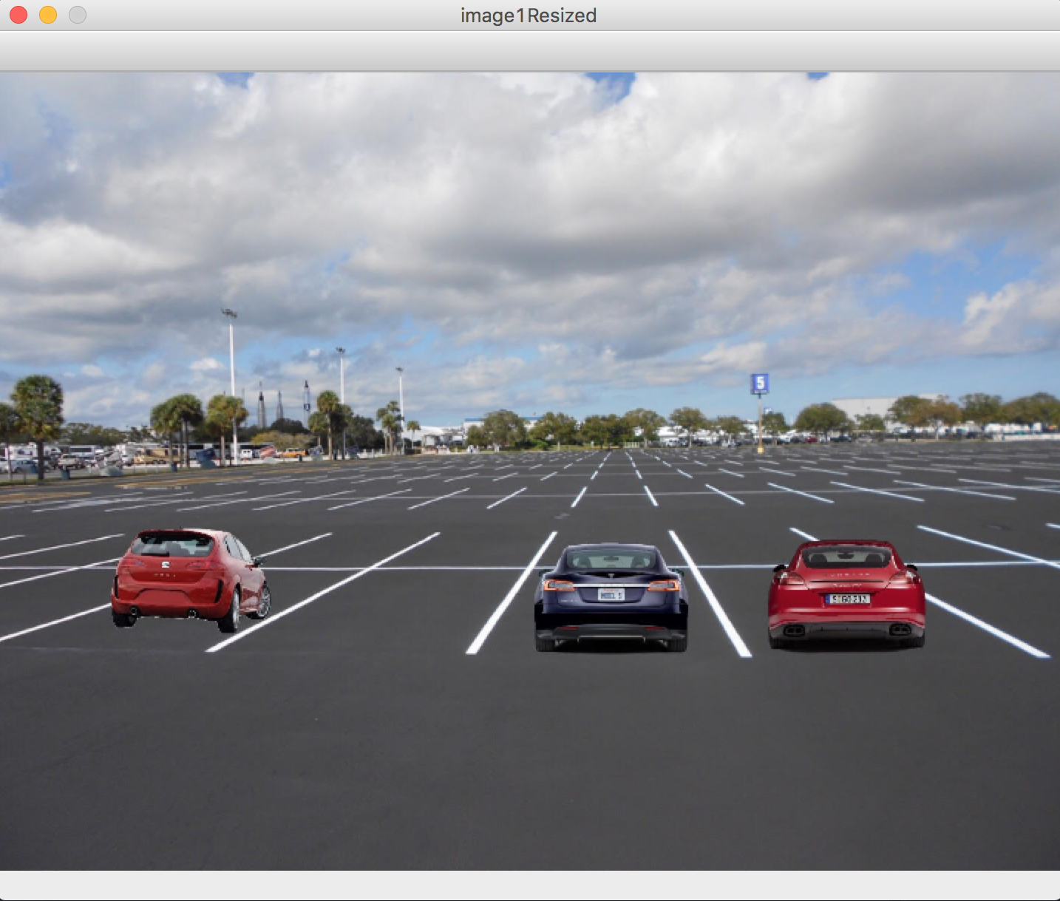
Canny Image Recognition Method
Camera takes picture of parking lot
Using Canny Edge Detection algorithm, edges and objects can be found
Average light densities of certain areas are found
If the average is higher than the threshold value, the spot has changed. Else, hasn’t changed
Canny Edge
Original

Slide 17
Frontend Implementation
HTML for a basic website shell.
Google Maps API to display locations of parking spaces.
Ajax call to get json from the database.

Slide 18
Backend testing
Using unittest for unit test
Coverage for statement coverage
Difficulty with testing images

Slide 19
Frontend Testing
Using cypress for frontend testing
Ran into an issue with having HTML element over google maps object not letting the testing framework click the marker.
Notes:
q

Slide 20
Demo

